Slide 2
explore concepts of Apache pig
learn Architecture of Apache Pig
understand Pig-Latin data types
learn Application of Pig
explore features of pig

Slide 3
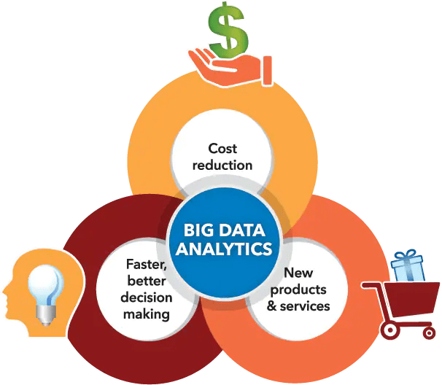
Introduction

Slide 4

Introduction

Slide 5

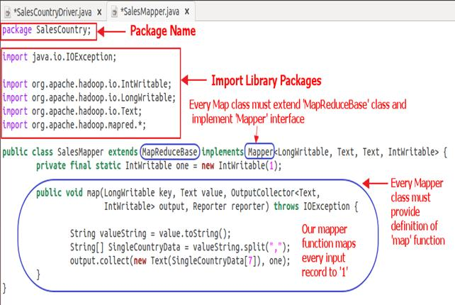
Introduction
Challenging to write and
Maintain these lengthy Java codes

Slide 6

Introduction

Slide 7

Introduction
Developed
By

Slide 8
Introduction
For people who don't know how to programme in Java, this is a godsend.

Slide 9
Introduction
For people who don't know how to programme in Java, this is a godsend.
Most Popular

Slide 10
Introduction
For people who don't know how to programme in Java, this is a godsend.
Most Popular
flexibility,

Slide 11
Introduction
For people who don't know how to programme in Java, this is a godsend.
Most Popular
flexibility,
reduces code complexity

Slide 12
Introduction
For people who don't know how to programme in Java, this is a godsend.
Most Popular
flexibility,
reduces code complexity
requires less effort

Slide 13
Map Reduce vs. Apache Pig
Why the name PIG?

Slide 14
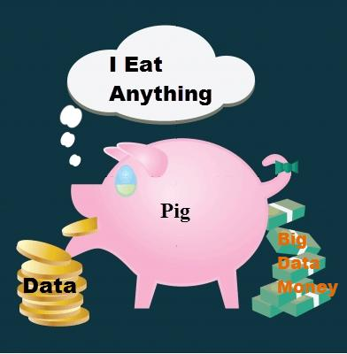
Map Reduce vs. Apache Pig
Why the name PIG?

Slide 15
Architecture of PIG
Components

Slide 16
Architecture of PIG
Components
Pig Latin data model

Slide 17
Architecture of PIG
Components
Pig Latin data model
Pig Job Execution Flow in depth

Slide 18
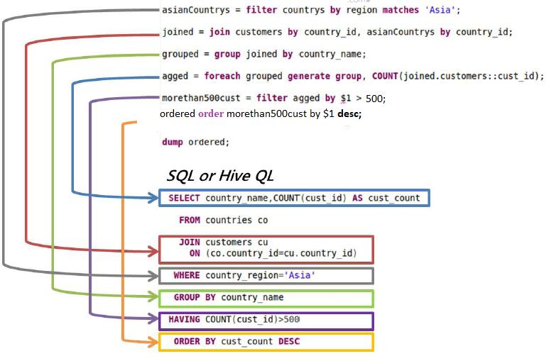
Architecture of PIG
Pig Latin

Slide 19
Architecture of PIG
Pig Latin Scripts
Grunt Shell
Pig Server
Parser
Optimizer
Compiler
Execution Engine
MapReduce
HDFS

Slide 20
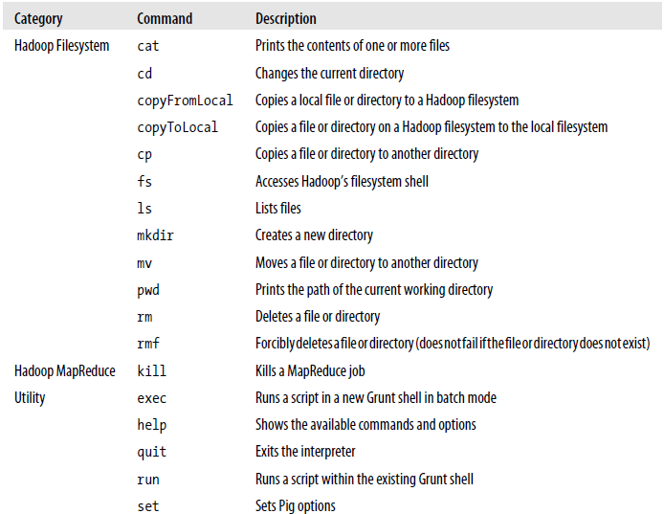
Apache Pig Components
Parser
Commands

Slide 21
Apache Pig Components
Syntax check
Parser

Slide 22
Apache Pig Components
Syntax check
Type check
Parser

Slide 23
Apache Pig Components
Syntax check
Type check
Parser
DAG(Directed Acyclic Graph)

Slide 24
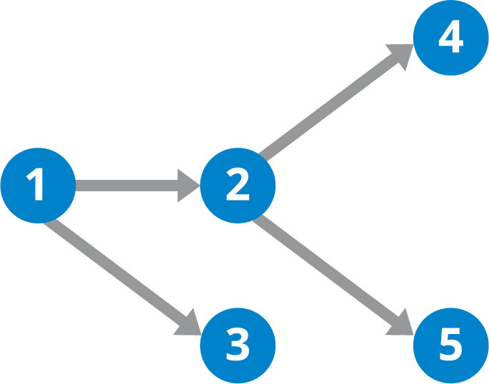
Apache Pig Components
DAG(Directed Acyclic Graph)

Slide 25
Apache Pig Components
Optimizer
Projection
Push Down

Slide 26
Apache Pig Components
Compiler

Slide 27
Apache Pig Components
Compiler
Compiles

Slide 28
Apache Pig Components
Compiler
Compiles
Optimized logical plan

Slide 29
Apache Pig Components
Execution engine

Slide 30
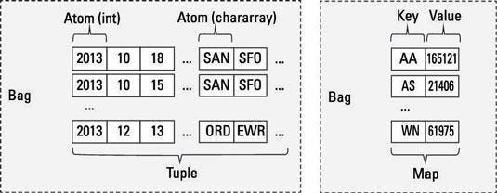
Pig Latin Data Model

Slide 31
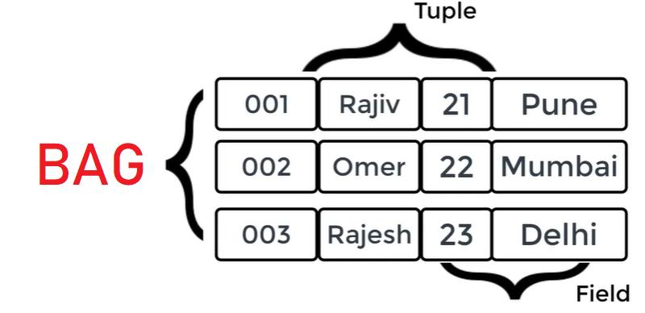
Pig Latin Data Model

Slide 32
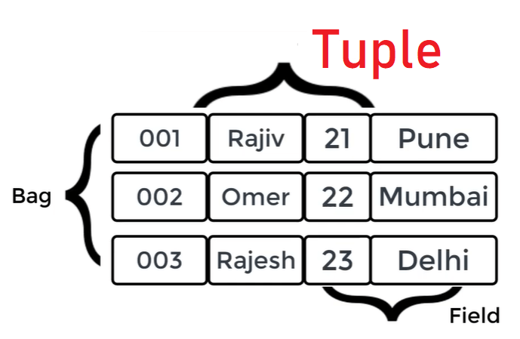
Pig Latin Data Model

Slide 33
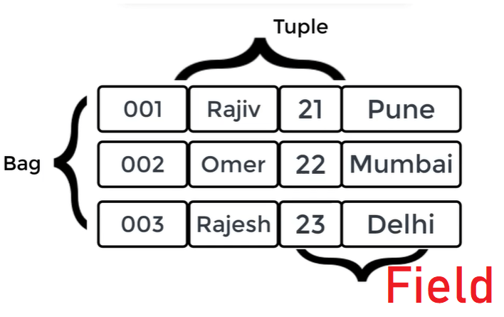
Pig Latin Data Model

Slide 34
Pig Latin Data Type
Data Type | Description | Example
Int | Represent a signed 32 bit integer | 8
long | Represent a signed 64 bit integer | 5L
float | Represent a signed 32 bit integer | 5.5L
double | Represent a signed 64 bit integer | 10.5L

Slide 35
Pig Latin Data Type
Data Type | Description | Example
Chararray | Represents a character array(string) in Unicode UTF-8 format | ‘Online Classes’
Bytearray | Represents a Byte array(blob)
Boolean | Represents a Boolean values | True/false

Slide 36
Pig Latin Data Type
Data Type | Description | Example
Datetime | Represents a Date-time. | 1970-01-01T00:00:00.000+00:00
BigInteger | Represents a java Biginteger | 60708090709
Bigdecimal | Represents a Bigdecimal | 185.98376256272893883

Slide 37
Pig Latin Data Type
Complex Types
Data Type | Description | Example
Tuple | A tuple is an ordered set of fields | (raja,30)
Bag | A bag is a collection of tuples | {(raju,30),(Mohammad,45)}
Map | A Map is a set of key-value pairs | [‘name’#’Raju’,’age’#30]

Slide 38
Pig Latin – Arithmetic Operators
Operator
+ Addition
- Subtraction
* Multiplication
/ Division
% Modulus
Bincond
Case

Slide 39
Pig Latin – Arithmetic Operators
Bincond:
Evaluates the Boolean operators. It has three operands as shown below.
variable x = (expression) ? value1 if true : value2 if false.

Slide 40
Pig Latin – Arithmetic Operators
Bincond:
b = (a == 1)? 20: 30;
if a = 1 the value of b is 20.
if a!=1 the value of b is 30.

Slide 41
Pig Latin – Arithmetic Operators
Case − The case operator is equivalent to nested bincond operator.
CASE f2 % 2
WHEN 0 THEN 'even'
WHEN 1 THEN 'odd'
END

Slide 42
Pig Latin – Comparison Operators
==Equal
!=Not Equal
>Greater than
<Less than
>=Greater than or equal to
<=Less than or equal to
Matches(Pattern matching )

Slide 43
Pig Latin – Type Construction Operators
Operator- Description
() – Tuple constructor operator
{} - Bag constructor operator
[] - Map constructor operator

Slide 44
Pig Latin – Relational Operators
Operator- Description
Loading and Storing
LOAD
STORE
Filtering
FILTER
DISTINCT
FOREACH, GENERATE
STREAM
Grouping and Joining
JOIN
COGROUP
GROUP
CROSS

Slide 45
Pig Latin – Relational Operators
Sorting
ORDER
LIMIT
Combining and Splitting
UNION
SPLIT
Diagnostic Operators
DUMP
DESCRIBE
EXPLAIN
ILLUSTRATE

Slide 46
Applications of Apache Pig:
For exploring large datasets Pig Scripting is used.
Provides the supports across large data-sets for Ad-hoc queries.
In the prototyping of large data-sets processing algorithms.

Slide 47
Applications of Apache Pig:
Required to process the time sensitive data loads.
For collecting large amounts of datasets in form of search logs and web crawls.
Used where the analytical insights are needed using the sampling.

Slide 48
Features of Apache Pig
Rich set of operators
Ease of programming
Optimization opportunities
Extensibility
UDF’s
Handles all kinds of data

